Slide 1

Basic Details of the Team and Problem Statement
Ministry/Organization Name/Student Innovation: Government eMarketplace
PS Code: SIH1357
Problem Statement Title: Sentiment analysis of Social Media presence
Team Name:
Team Leader Name: Shrishail patil
Institute Code (AISHE):
Institute Name: Vellore Institute of Technology
Theme Name:

Slide 2
Idea/Approach Details
PROBLEM STATEMENT:-
This problem involves developing a sentiment analysis solution specifically designed for analyzing the sentiment expressed in the social media presence of individuals and organizations. With the significant impact of social media on personal and organizational reputation, understanding the sentiment of social media posts, comments, and interactions has become essential for individuals and businesses alike. Sentiment analysis refers to the process of automatically determining the sentiment or emotional tone conveyed by text or speech. In the context of social media, sentiment analysis can provide valuable insights into public perception, customer feedback, and brand reputation. By analyzing the sentiments expressed in social media content, individuals and organizations can gauge the overall sentiment trends, identify potential issues, and take appropriate actions to maintain or enhance their online presence.
FLOWCHART
START
Choose relevant social media and provide content link
Sentiment Analysis of Social Media Presence allows us to understand what people feel and express about our brand, products, or services. By analyzing the sentiment (emotions, opinions, and attitudes) - whether it's positive, negative, or neutral - we gain valuable insights that guide our strategies, enabling us to engage with our audience effectively and tailor our offerings to meet their needs and preferences.
Our software analyses the content on the link provided and presents a detailed review on the emotions, opinions, and attitudes expressed in the social media content using an efficient ML model.
Scraping data and extracting relevant information using python libraries, APIs and ML
Technology used:-
HTML
CSS
Bootstrap
Flask
ReactJs
NodeJs
Python
API
ML
Firebase
Showing the analysis output(number of likes and views and sentiment analysis of the comments in the post)
END

Slide 3
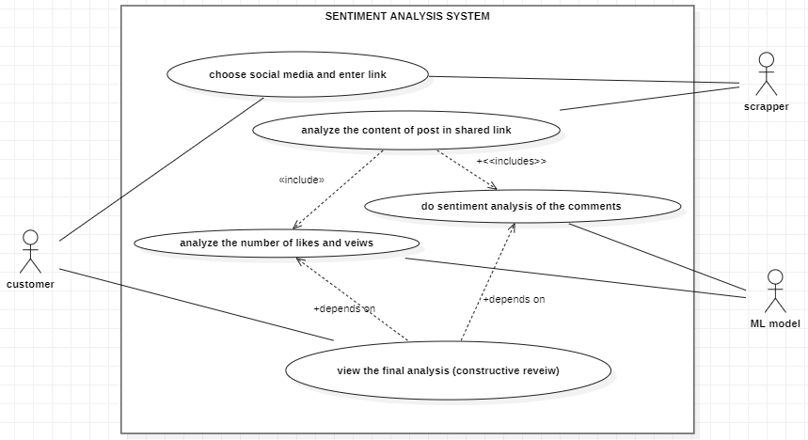
Idea/Approach Details
USE CASES:-
Filling out the form by choosing appropriate social media and enter link.
See the final analysis of the post provided in the link (includes engagement statistics and sentiment analysis of comment section).
SHOW STOPPERS:-
Lack of customers
DEPENDENCIES:-
Customer (for providing link )
Web scrapper ( for extracting data)
ML model ( for analysis)

Slide 4
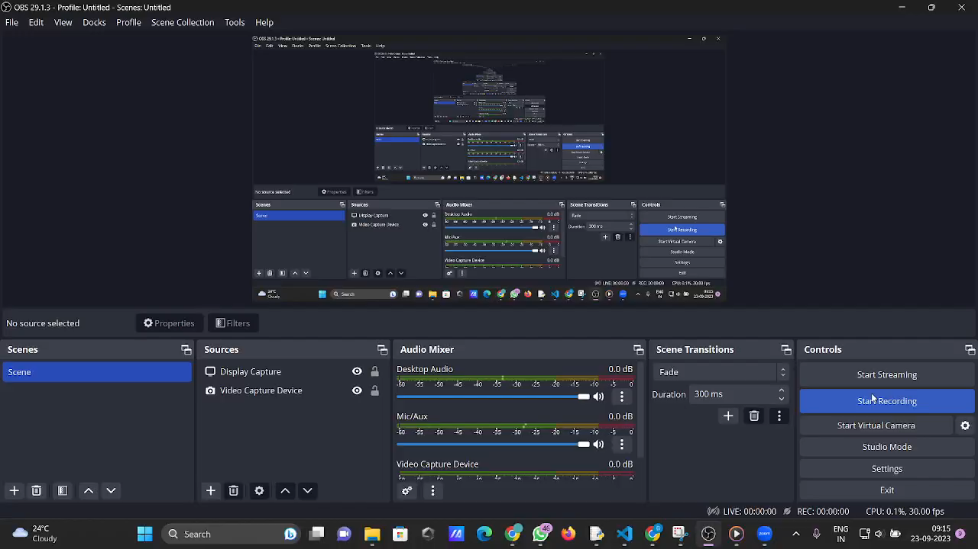
SAMPLE OUTPUT
[ input : Instagram --> Profile --> Link]

Slide 5
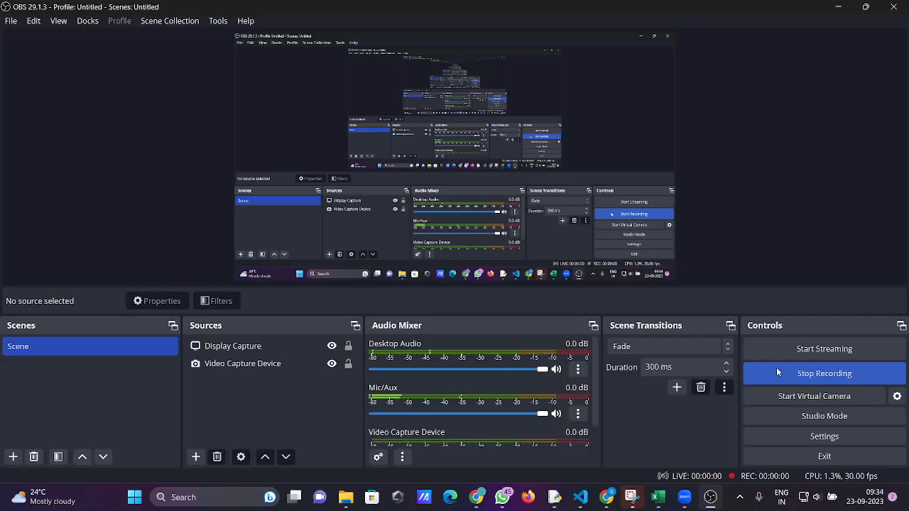
SAMPLE OUTPUT
[ input : Instagram --> Comments --> Link]

Slide 6
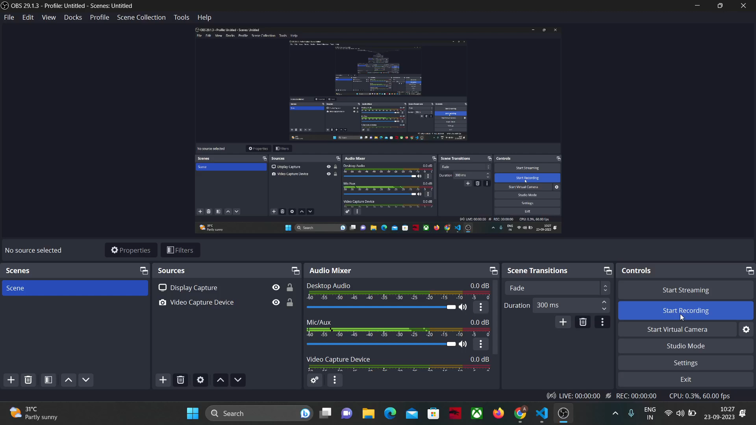
SAMPLE OUTPUT
[ input : Facebook--> Comments--> Link]

Slide 7
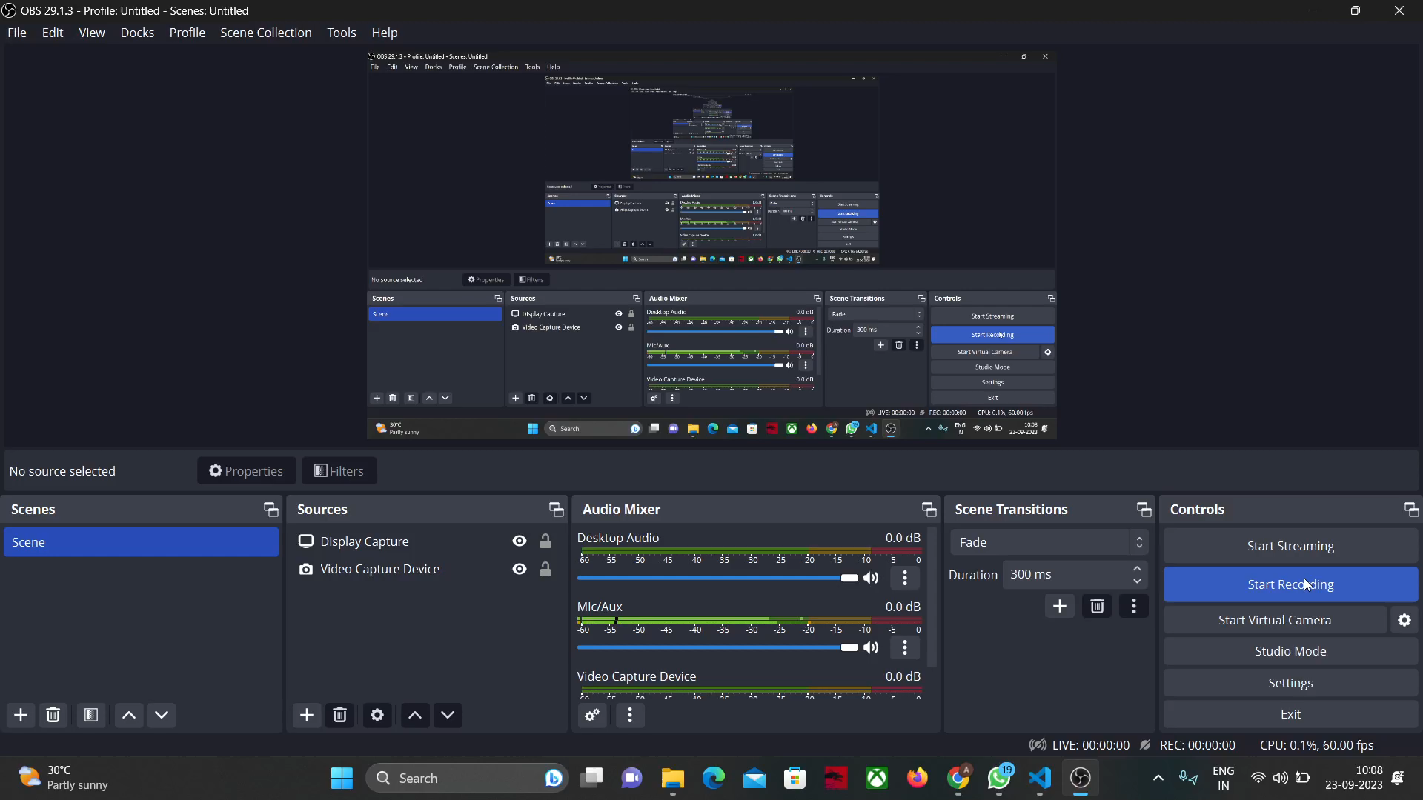
SAMPLE OUTPUT
[ input : Twitter--> Comments--> Link]

Slide 8
Links:-
Github Repository link: https://github.com/shrishail356/mood_flickers
Website link : https://moodflickers.onrender.com

Slide 9
Libraries Used:-
Pandas python library: The pandas library is a popular open-source Python library used for data manipulation and analysis. It is made mainly for working with relational or labeled data both easily and intuitively. It provides various data structures and operations for manipulating numerical data and time series. It can do data set cleaning, merging, and joining, data Visualization, etc.
Matplotlib python library: Matplotlib is an amazing visualization library in Python for 2D plots of arrays. Matplotlib is a multi-platform data visualization library built on NumPy arrays. It is used for data visualization , plotting , statistical analysis, 3d plots and animations,etc.
ApifyClient : ApifyClient is a software development kit (SDK) provided by Apify, a platform designed to simplify web scraping, automation, and data extraction tasks. Apify focuses on making web scraping accessible to both developers and non-developers, allowing them to easily gather data from websites for various purposes, such as market research, competitive analysis, and content aggregation.
Flask: Flask is a lightweight and flexible web application framework for Python. It's designed to make it easy to build web applications and APIs. Flask provides the basic tools and libraries needed to create web applications, but it leaves many aspects of development up to the developer, giving them the freedom to choose how they want to structure their application.

Slide 10
EXPLAINATION OF THE CODE
Import Statements: The script imports necessary modules for creating a Flask web application, handling HTTP requests, data manipulation with pandas, using ApifyClient for interacting with the Apify API, and working with dates and times.
Flask App Initialization: Initializes a Flask application. The static_url_path and static_folder parameters specify the path to static files like CSS, JavaScript, etc.
Apify API Client Setup: Initializes Apify clients for Instagram, Facebook, and Twitter using API keys.
Route Definitions:
index(): Renders the 'firstpage.html' template when the root URL is accessed.
get_started(): Handles a form submission from 'getstarted.html', processes the input, and redirects back to the index page.
scrape(): Handles form submissions with data for scraping social media content.
Depending on the platform and content type, it makes API calls to Apify, processes the returned data, and renders corresponding templates.
Template Rendering: render_template() is used to render HTML templates. Templates are located in folders specified in the render_template() function.
Filter Registration: Registers the format_timestamp function as a custom filter for use in the HTML templates. This filter can be used to format timestamps.
Main Execution Block: Starts the Flask application in debug mode if the script is run directly.

Slide 11
Explaination of scrape() definition :-
Route Definition:This defines a route for the URL path /scrape that accepts POST requests.
Request Handling:This retrieves the values submitted in the form for platform and content_type.
Instagram:
Comments : If content_type is comments, it extracts the Instagram post URL, prepares the input for the Apify actor to scrape comments, processes the results, and renders the instagram_comments.html template with the data.
Posts : If content_type is posts, it extracts the Instagram username, prepares the input for the Apify actor to scrape posts, processes the results, and renders the instagram_posts.html template with the data.
Profile : If content_type is profile, it extracts the Instagram username, prepares the input for the Apify actors to scrape posts and profile information, processes the results, and renders the instagram_profile.html template with the data.
Overview : If content_type is overview, it extracts an Instagram profile name, prepares the input for the Apify actor to scrape profile information, processes the results, and renders the instagram_overview.html template with the data.
Similar process has been followed for facebook and twitter.
Return Statement : If none of the specified conditions are met (i.e., platform or content type doesn't match), this statement is executed, returning the string "No data scraped."

Slide 12

Benefits of Sentiment Analysis
Understanding Customer Sentiment: Sentiment analysis helps in understanding how customers feel about a product, service, brand, or a specific topic. This insight is invaluable for making informed business decisions.
Reputation Management: It allows businesses to monitor and manage their online reputation by identifying and addressing negative sentiment before it escalates.
Customer Feedback Analysis: Sentiment analysis automates the process of analyzing customer feedback, saving time and resources. It also helps in identifying trends and common pain points.
Competitor Analysis: By analyzing the sentiment around competitors, businesses can gain insights into areas where their competition may be falling short, providing opportunities for differentiation.
Market Research and Trend Analysis: Sentiment analysis provides insights into market trends, customer preferences, and emerging topics, which can be used to inform business strategies.
Enhancing Customer Experience: By addressing negative sentiment and feedback, businesses can improve customer satisfaction and overall experience, leading to higher customer retention rates.
HOW TO DO FUTURE PLANNING USING THIS ?
Anticipating Customer Preferences: By analyzing sentiment, businesses can gain insights into customer preferences, allowing them to proactively plan content, products, and services that align with what their audience wants.
Identifying Emerging Trends: Sentiment analysis can reveal emerging topics and trends in the industry or market, enabling businesses to stay ahead of the curve in their content and offerings.
Enhancing Customer Engagement: Knowing what resonates positively with the audience allows for more effective engagement strategies. Businesses can plan campaigns and interactions that are likely to generate positive responses.
Risk Mitigation: By monitoring sentiment, businesses can identify potential issues or controversies early on. This allows for a proactive approach to mitigate risks and address concerns before they escalate.
Competitive Edge: Analyzing sentiment around competitors can provide insights into areas where they may be falling short. This information can inform account planning to capitalize on those weaknesses.

Slide 13
Team Member Details
Team Leader Name: Shrishail Patil
Branch (Btech/Mtech/PhD etc): Btech Stream (ECE, CSE etc): CSE Year (I,II,III,IV): III
Team Member 1 Name: Aditya Choudhary
Branch (Btech/Mtech/PhD etc): Btech Stream (ECE, CSE etc): CSE AI/ML Year (I,II,III,IV): III
Team Member 2 Name: Pranjal Singh
Branch (Btech/Mtech/PhD etc): Btech Stream (ECE, CSE etc): CSE Year (I,II,III,IV): III
Team Member 3 Name: Vishwash Patel
Branch (Btech/Mtech/PhD etc): Btech Stream (ECE, CSE etc): CSE Year (I,II,III,IV): III
Team Member 4 Name: Priyanka Dandapat
Branch (Btech/Mtech/PhD etc): Btech Stream (ECE, CSE etc): CSE Year (I,II,III,IV): III
Team Member 5 Name: Affan Umair
Branch (Btech/Mtech/PhD etc): Btech Stream (ECE, CSE etc): CSE Year (I,II,III,IV): III
Team Mentor 1 Name: R Jothi
Category (Academic/Industry): Expertise (AI/ML/Blockchain etc): Domain Experience (in years):

